Slide 1
Social
The land of snow

Slide 2
contents
Location
Land
Climate
Vegetation
Wildlife
Life of the people
Occupation
Important cites

Slide 3
The regions around the poles are called polar regions. Around the north pole is the artic ocean. This ocean is surrounded by asia, Europe and north America. Around the south pole is the continent of Antarctica.

Slide 4
Greenland
Greenland, the worlds largest island, is situated near the north pole. This country remains under snow and ice through out the year. The original inhabitants of the Greenland are the Inuits. They call their country Kalaallit Nunaat, which means ‘Land of people’.

Slide 5
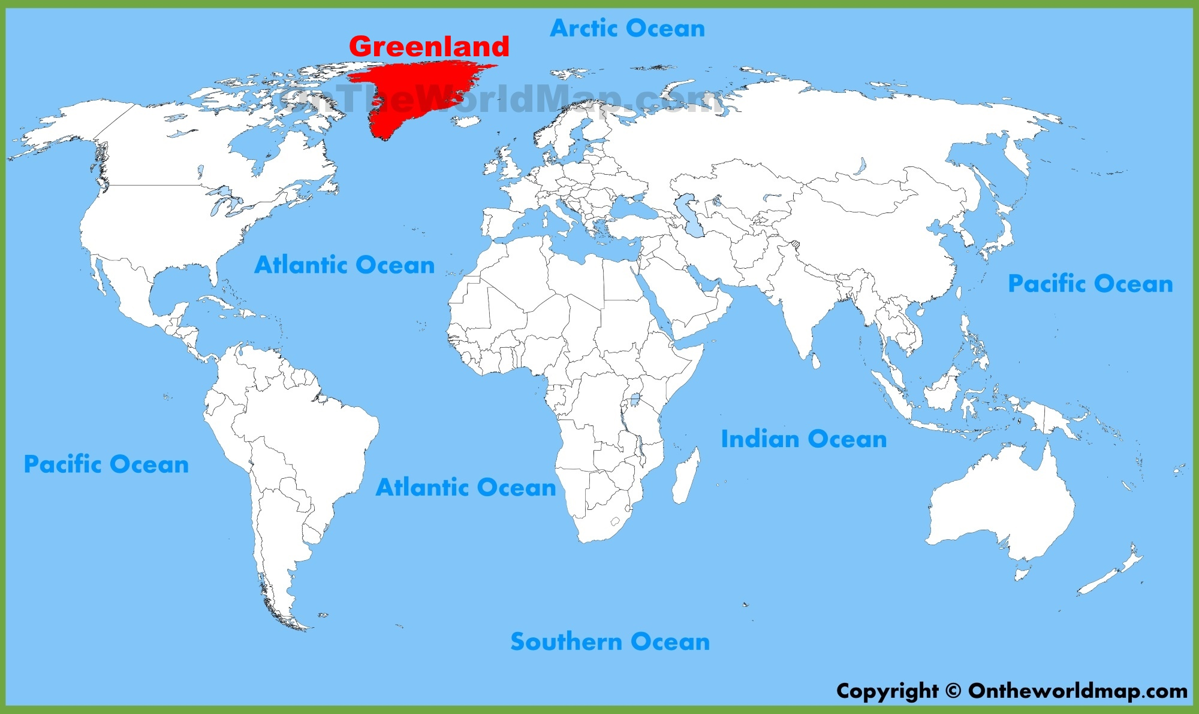
Location
Greenland is located towards the north east of north America. More than two thirds of island is located north of the artic circle. The Baffin bay and the Davis strait separate Greenland from the northern islands of Canada. Greenland is a part of Denmark.

Slide 6
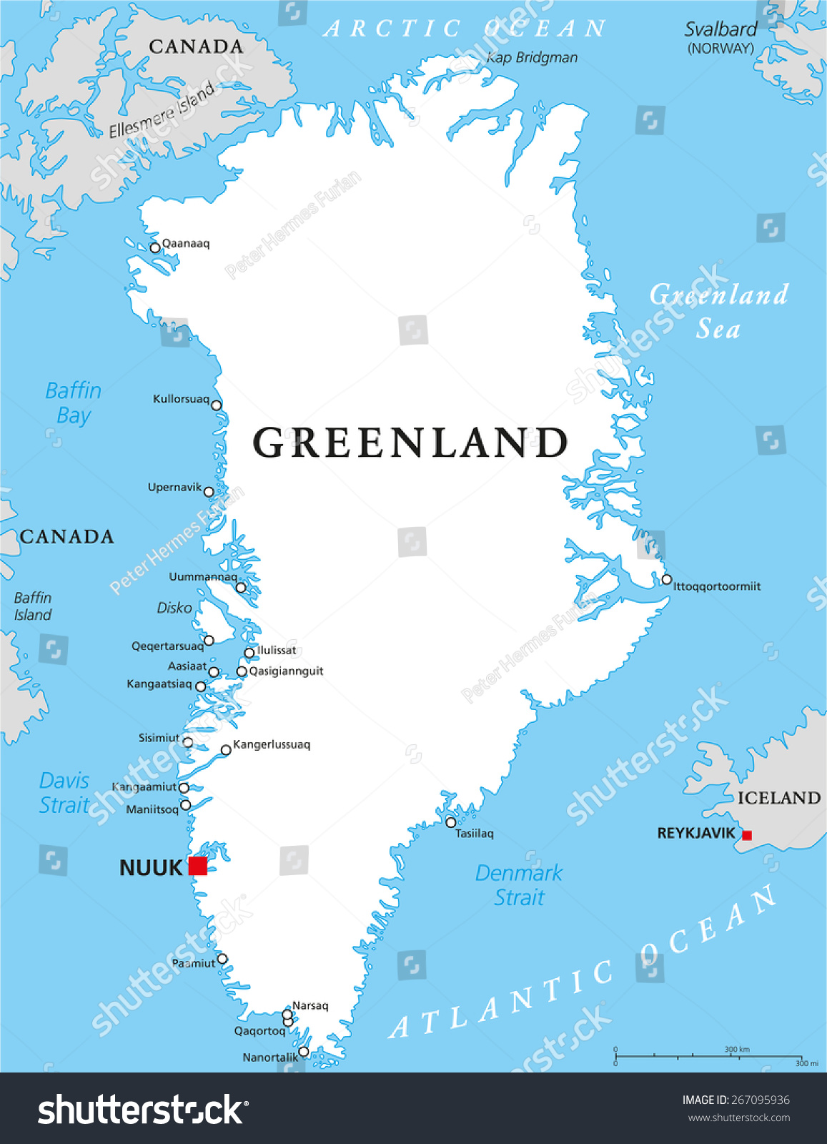
Land
Greenland covers an area of about 21.5 lakh square kilometres. The island looks white as about 80% of the land is permanently under snow and ice. The average thickness of ice sheet is about 1500 metres. The lower layers of the ice sheet may have existed since the last ice age.
Huge pieces of ice often break away from the ice sheets and slide down into the sea. These are called icebergs. These blocks of ice look like huge frozen mountains floating in the sea. These are often not visible due to thick fog. Icebergs are very dangerous for ships that sail through this region.

Slide 7
Climate
Greenland has an artic type of climate. The winters are long and cold. The sun does not rise for several weeks. The temperature drops below the freezing point and snows heavily. Extremely cold and chilly winds blow here. The summer is short and cool. The weather is bright in sunny, especially in the coastal areas. Even though there is continuous sunlight for several weeks, it is still very cold.

Slide 8
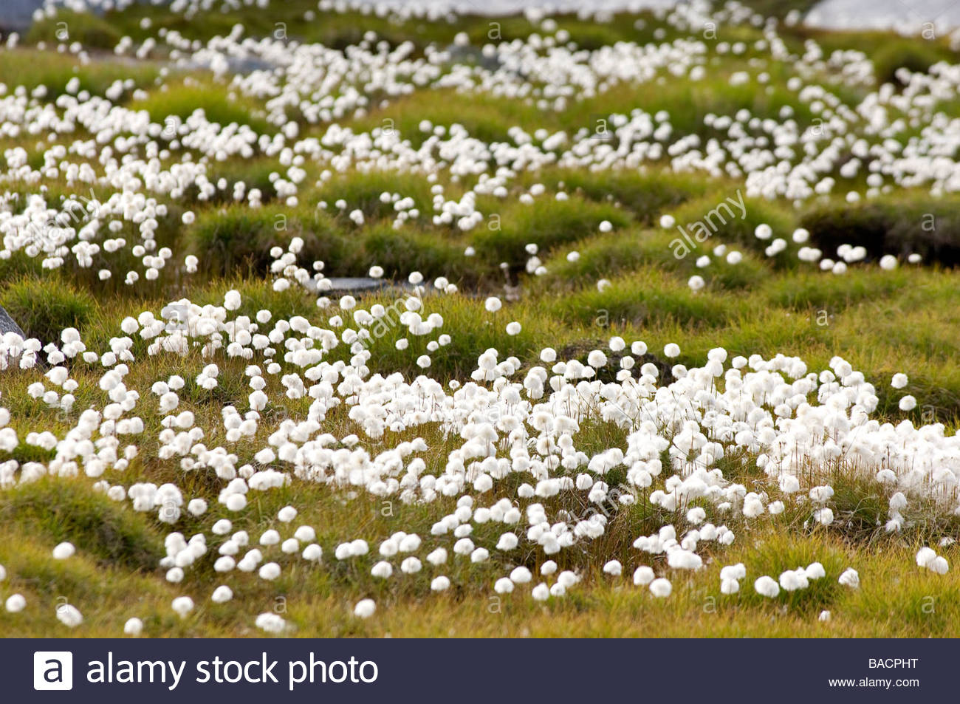
Vegetation
Seeds germinate and plants grow in the summer season. The only plants that grow here are mosses, lichens, grasses and bushes. Some flowers bloom in spring. Both summer and spring are short in Greenland. There are no forests here. No crops can grow due to the cold climate.

Slide 9
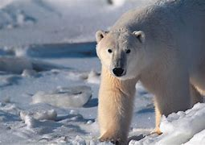
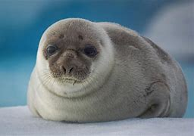
Wild life
Only animals with thick furry coats or those can withstand the extreme cold can survive in Greenland. Wolf like dogs called huskies are used for hunting and for pulling sledges.

Slide 10
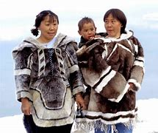
Life of the people
The Inuits (also called eskimos) came to green land from north America and settled here many years ago. Over time, they have adapted themselves to the harsh climate.
The Inuits are short and stout. They have flat faces, narrow eyes and copper yellow skin. They wear clothes made from the skin of seals. Their jackets, called parkas, have hoods to cover heads. They generally wear double trousers and high boots, also made of seal’s skin to keep themselves warm

Slide 11
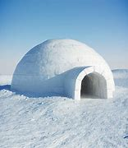
Life of the people ( cont)
The people who live in the extreme north build snow houses or igloos during the winter season. They use large blocks of ice to construct them. The igloos are dome shaped. A hole is made in the centre of the dome to allow smoke and hot air to pass through. The floor is covered with the skin and furs of animals. During summers , people have started living in modern houses.
The Inuits are hard working cheerful and hospitable people. For hundreds of years, they lived by hunting, fishing and gathering roots during summer and spring. In the past, they got most of the things they needed by hunting animals. Now a days, they can buy goods brought in from other countries.

Slide 12
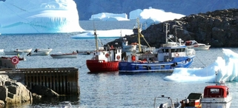
occupation
Inuits are skilled fisherman and hunters. They hunt animals for their meat, skin and fat. Earlier they used harpoons to hunt animals. Now they use automatic rifles.
The Inuits use small boats called kayaks to hunt sea animals. A broader boat called umiak, is used to hunt whales. They boats are used for transportation. On land, Inuits use sledges.
The lifestyle of Inuits has undergone many changes in the recent times. Now they use motor boats and motorised sledges. Many people also work in the mines and oil fields. A large number of Inuits have migrated to towns and cities.

Slide 13
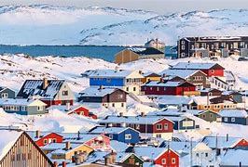
important Cities
The thick sheet of ice has restricted settlements to the coastal areas. There are very few large towns in green land. Nuuk(Godthab) is the capital and the largest city. Sisimiut and Ilulissat are the other big cities. The total population of Greenland is about 56,000.

